Slide 1
Wellcome to my project Presentation
Laravel news portal Blog_site

Slide 2
প্রজেক্টের উদ্দেশ্য
Laravel blog-site এর উদ্দেশ্য হলো একটি News portal ওয়েবসাইট কে Dynamically রক্ষণাবেক্ষণ করা। এবং রোল পারমিশন কৃত Author পোস্ট গুলো লাইফ পেজে প্রদর্শন করা।প্রত্যেকটি Mode a Click able page review করানোও , Category & Tags Wish post reviews করা।
PROJECT FEATURES
Authentication
Login& Registration
Search all web site Key and any word
Supper Admin Dashboard
User dashboard
Author Dashboard
Forget password
Role management
Dynamically Content Update
Show popular post
Category wish post revies
Tag Wish post reviews

Slide 3
Using Technology
HMTL
CSS
BOOTSTRAP
JAVASCRIPT
PHP
LARAVEL FREAMEWORK
Lets Go ……….

Slide 4
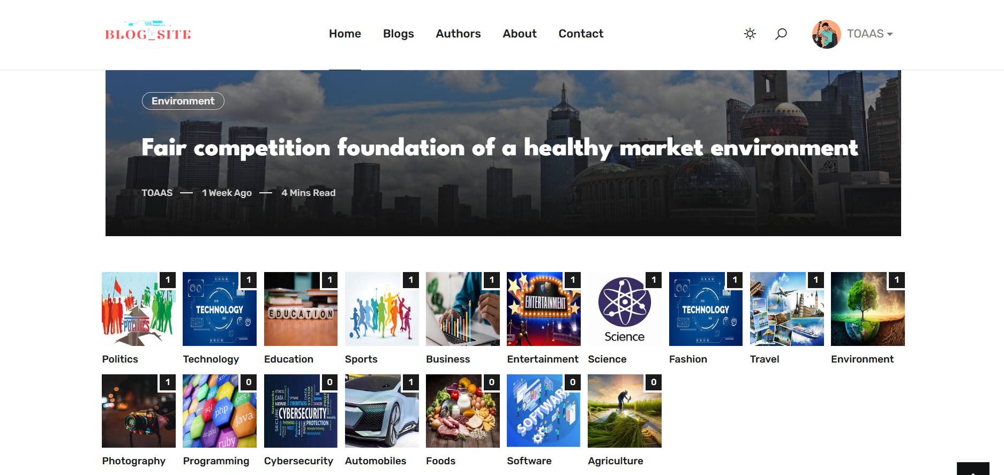
Laravel Blog_site Project Live page Preview

Slide 5
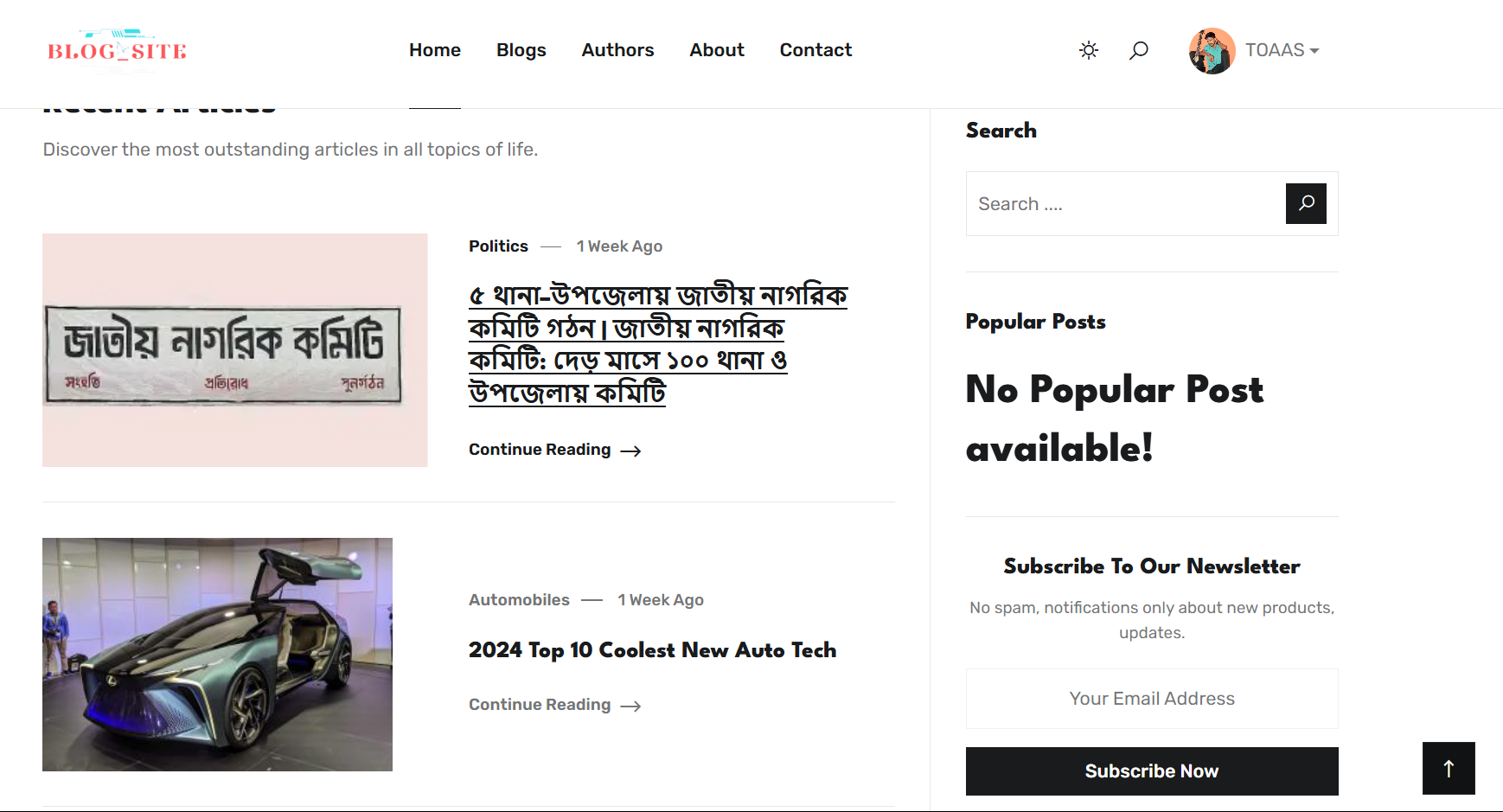
CONTENT Live page Preview

Slide 6
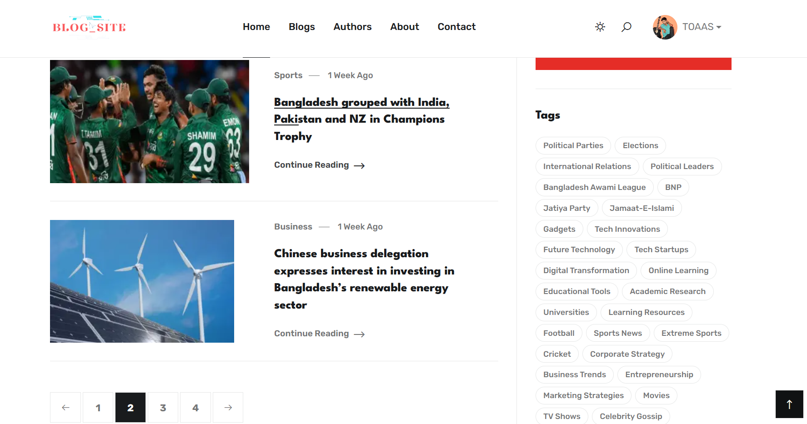
Tags Live page Preview

Slide 7
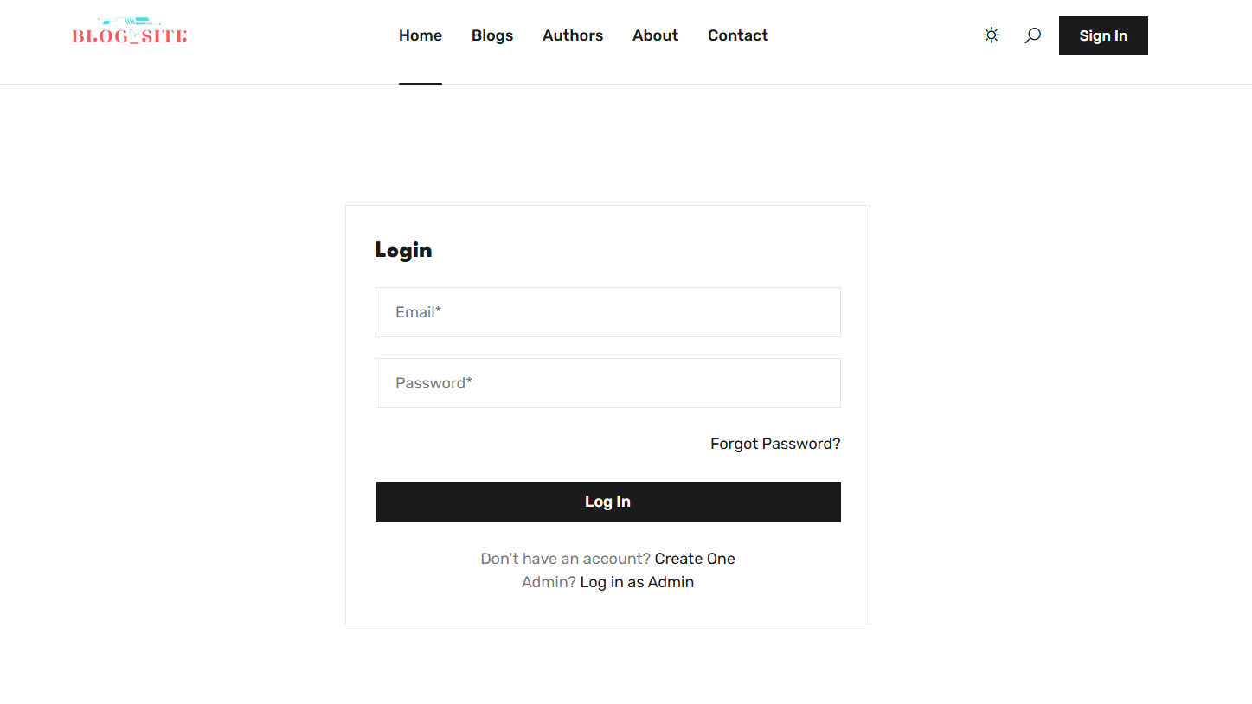
Login page author and user dashboard

Slide 8
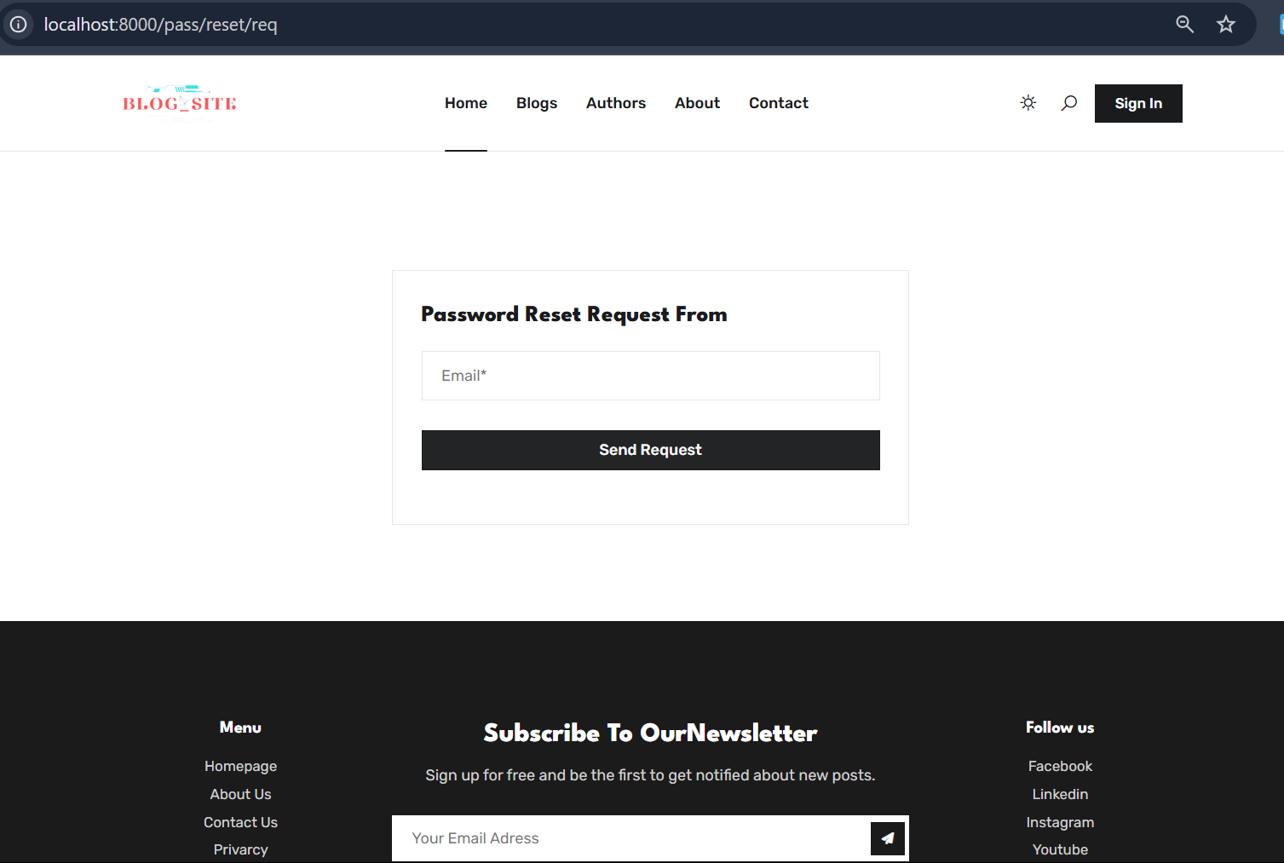
Reset your password and email verify

Slide 9
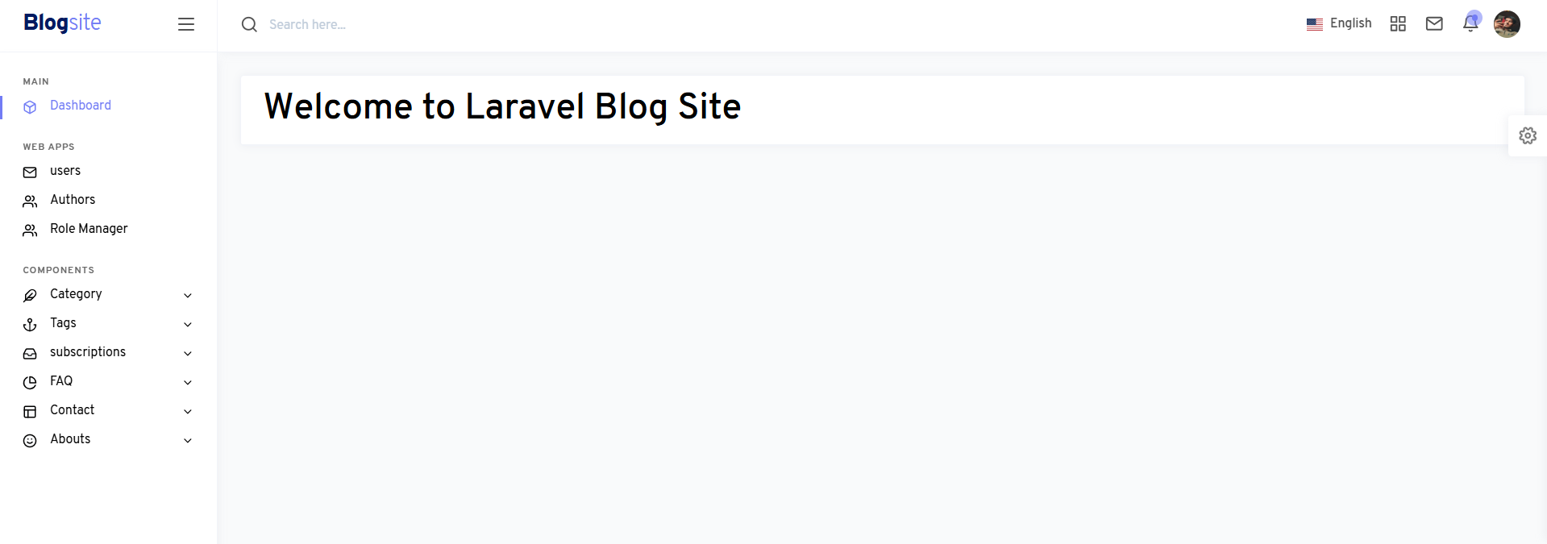
Dashboard information

Slide 10
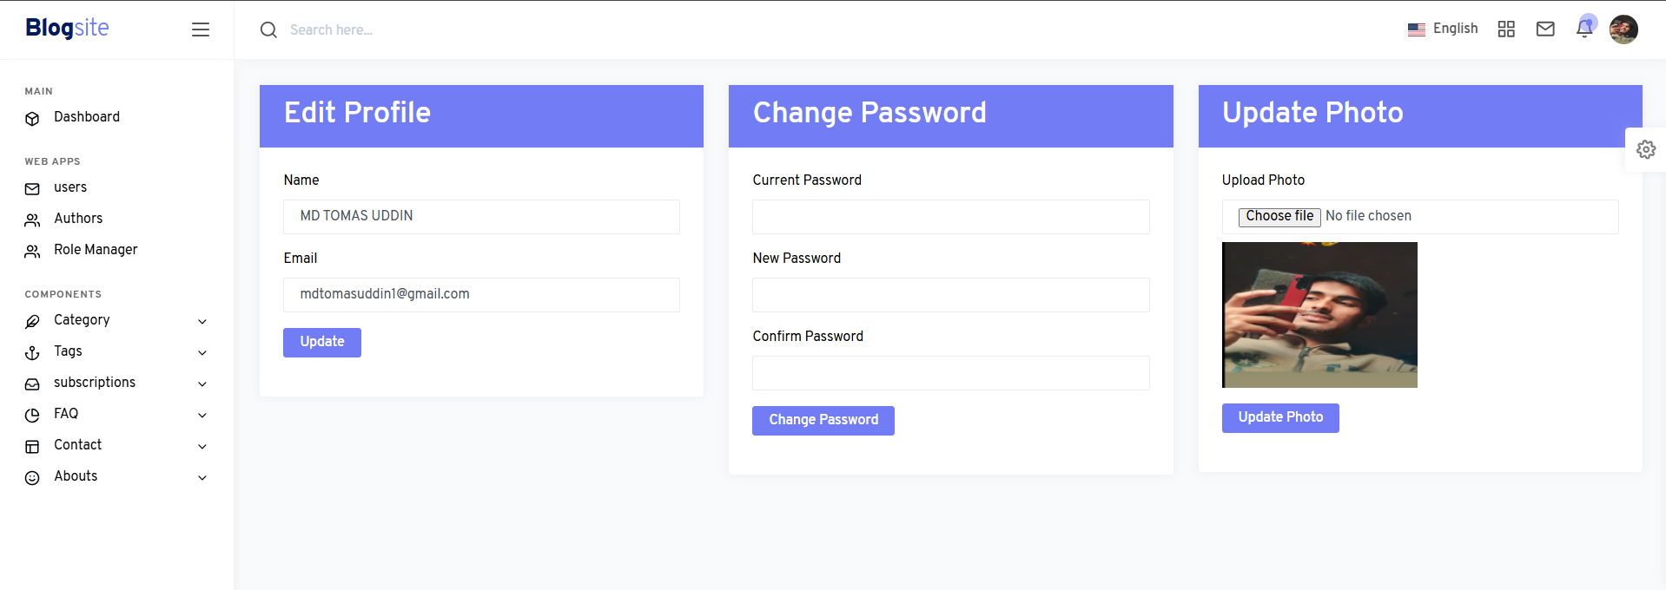
user change your Name,email,password,photos

Slide 11
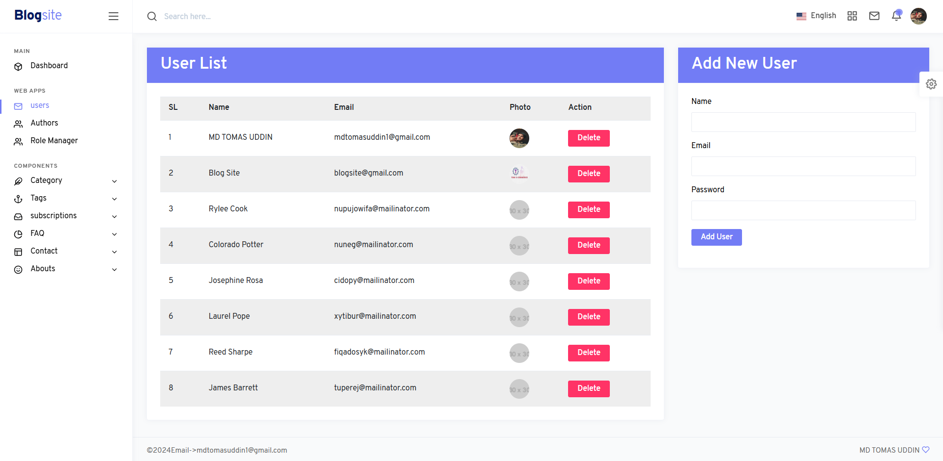
User all information

Slide 12
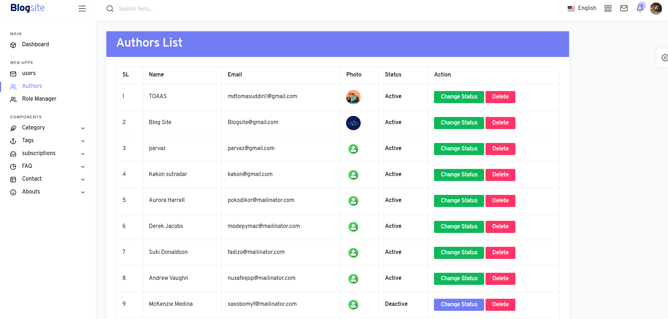
All Authors list show and Active status system

Slide 13
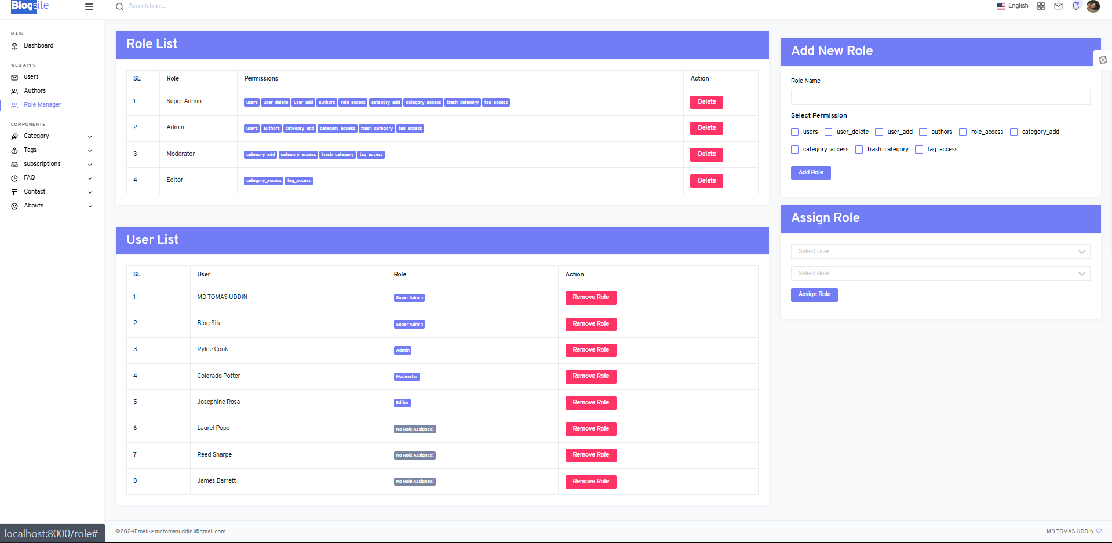
Role management System add /Delete role

Slide 14
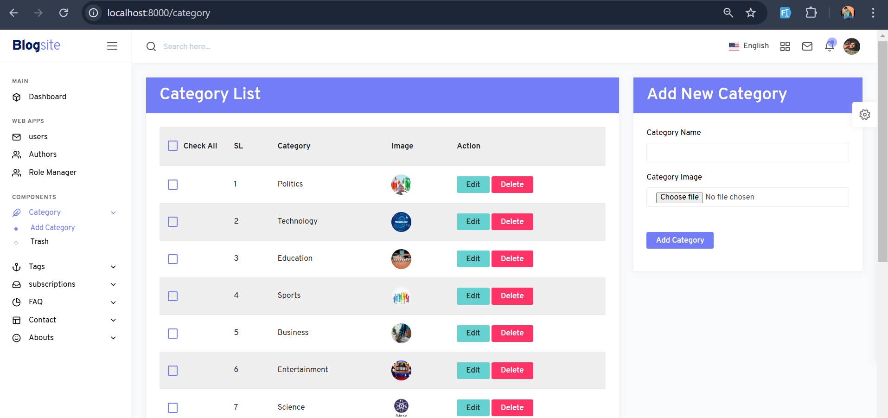
Category list and add new category
Category Edit/Delete option

Slide 15
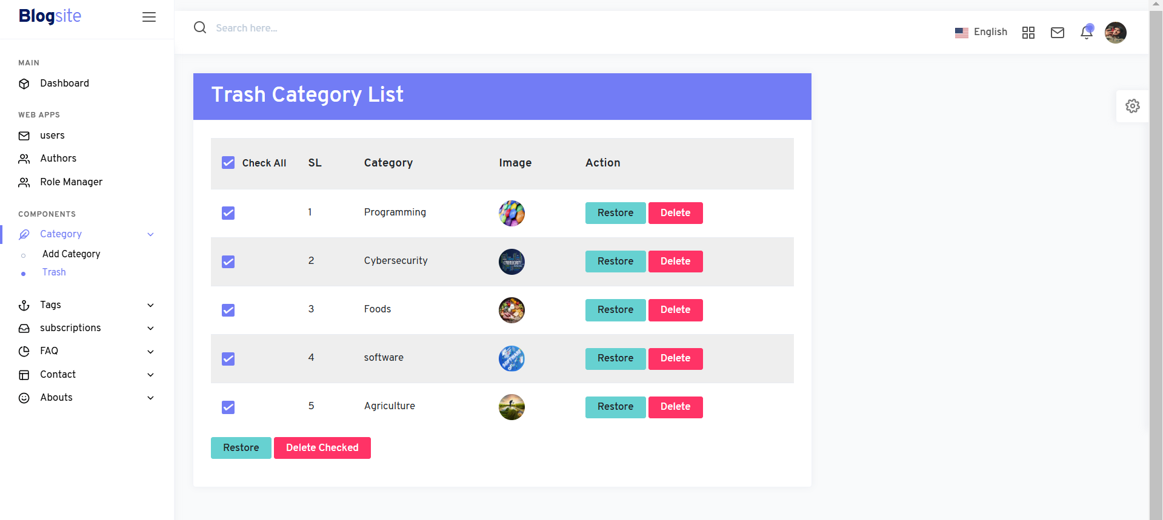
Category Trash Delete and Restore and permanent Delete

Slide 16
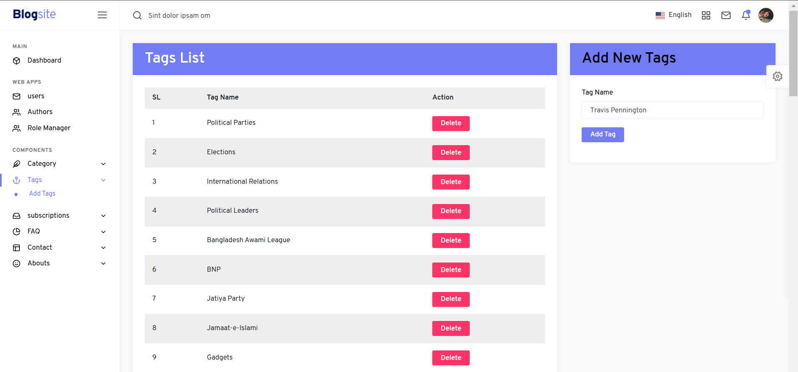
Tag list show and Add new Tags Items
->Delete user Tags option

Slide 17
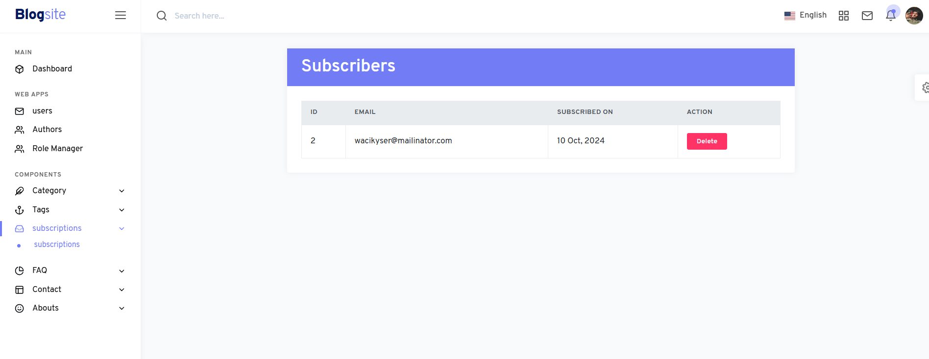
Subscriptions->show subscriber email ,date ,Delete option

Slide 18
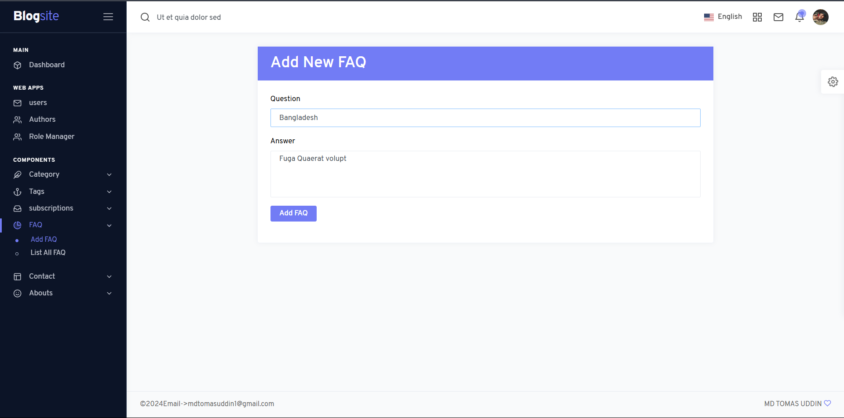
FAQ ADD

Slide 19
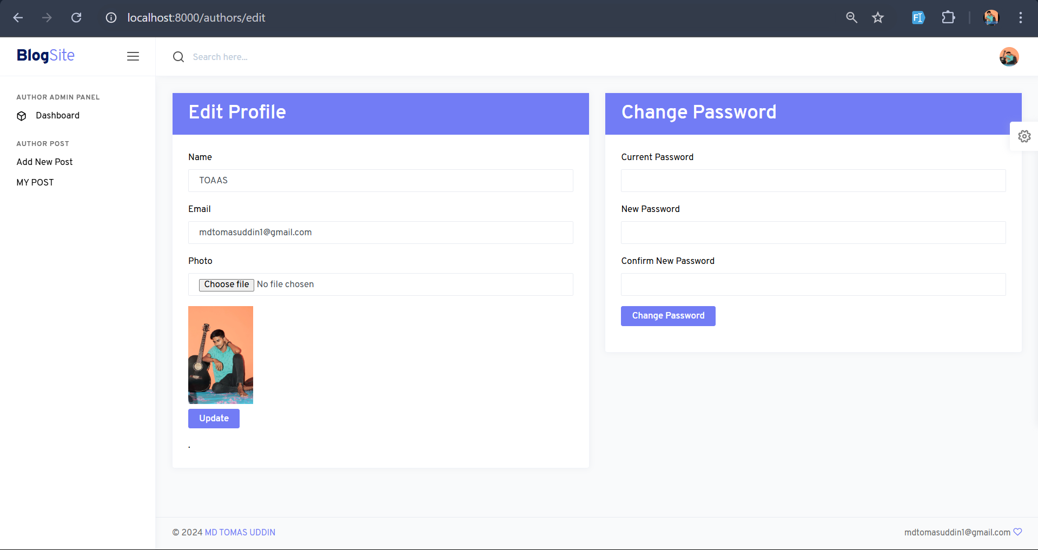
Author dashboard and profile information update system

Slide 20
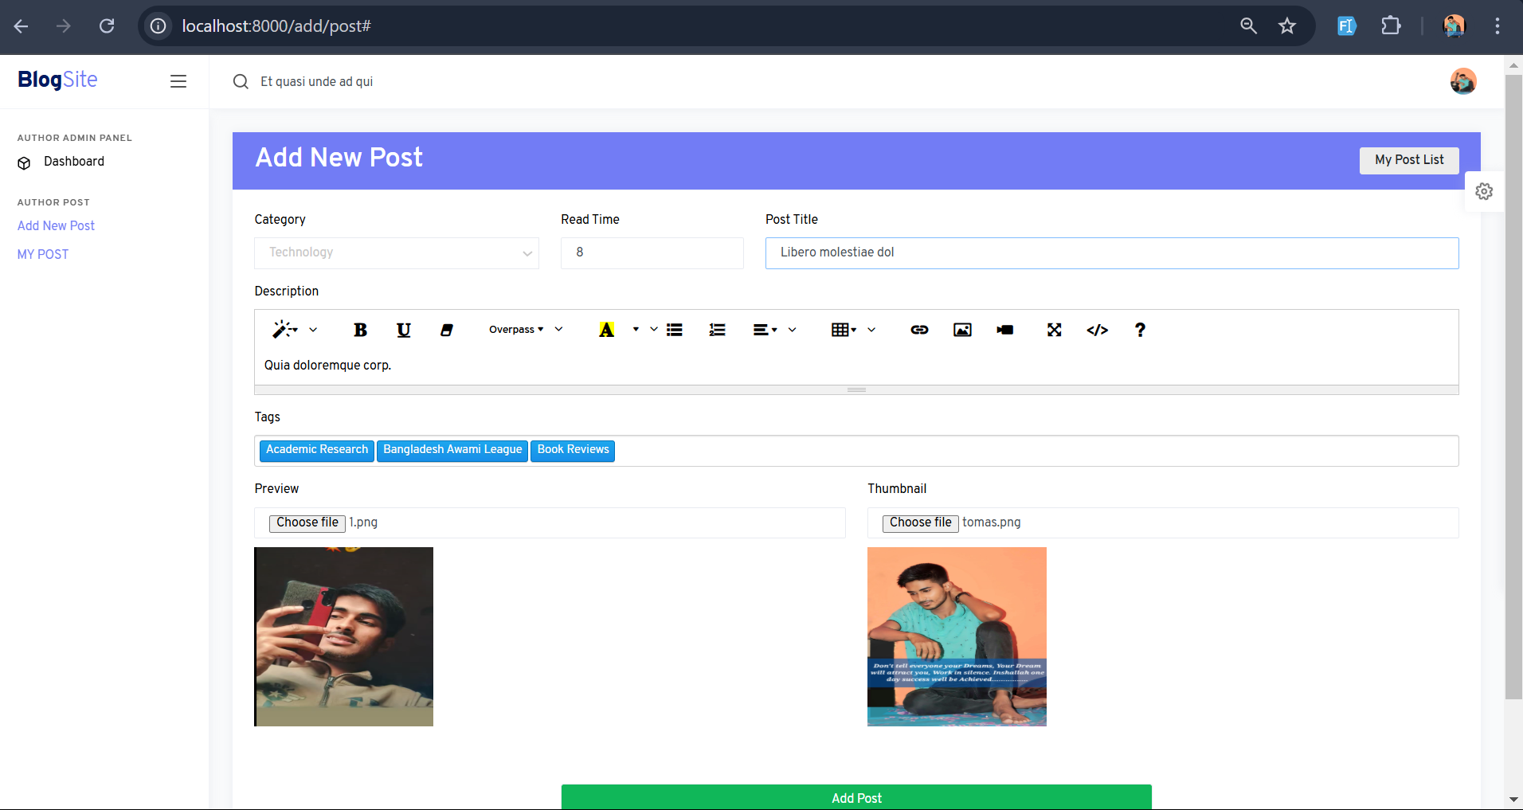
Author add new post

Slide 21
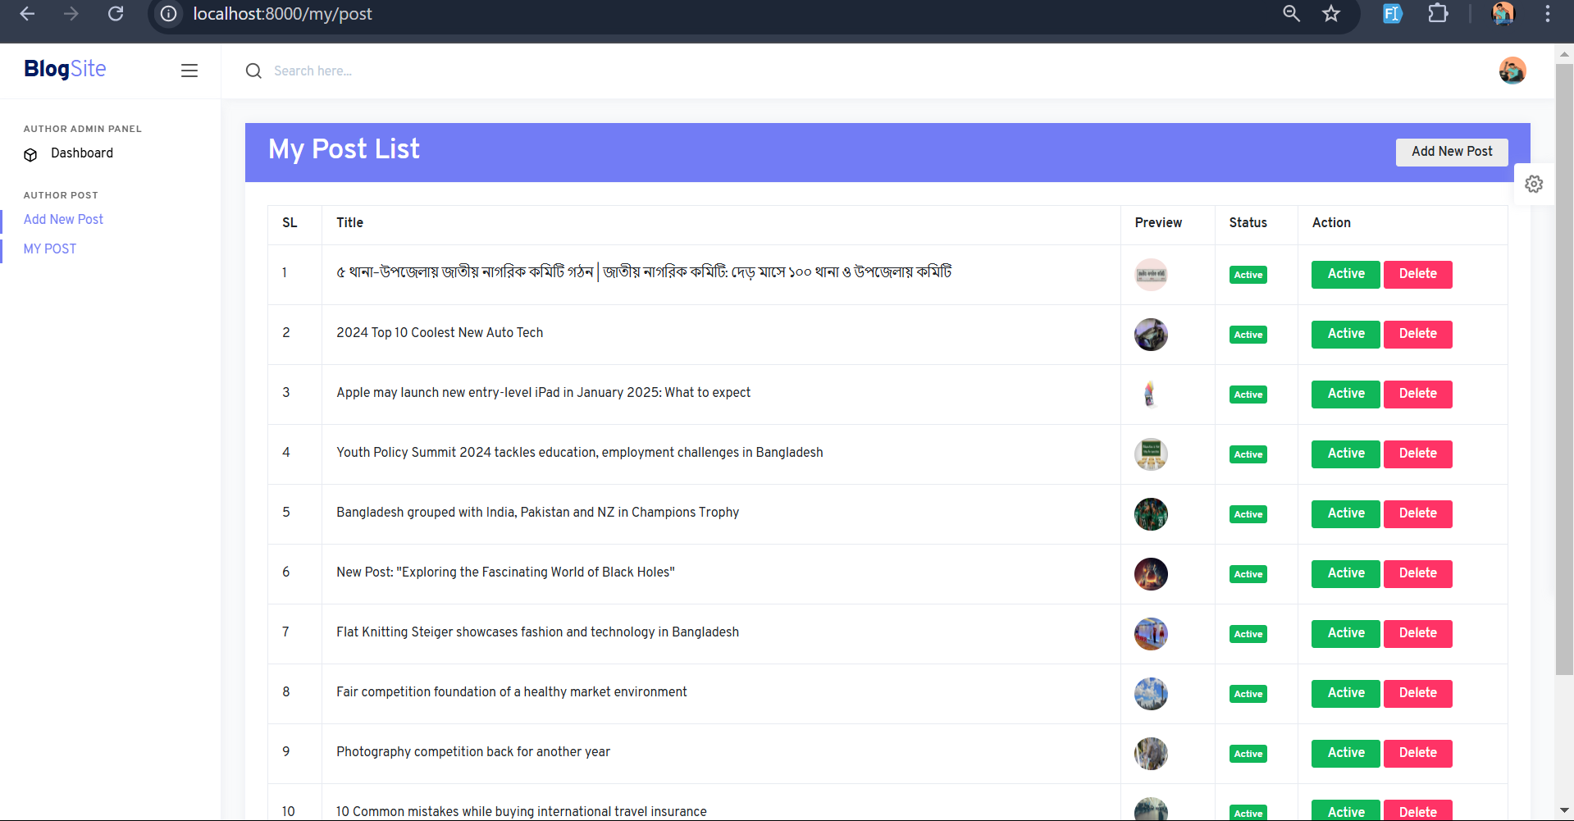
Author post status active and live page show ? Delete option Author post

Slide 22
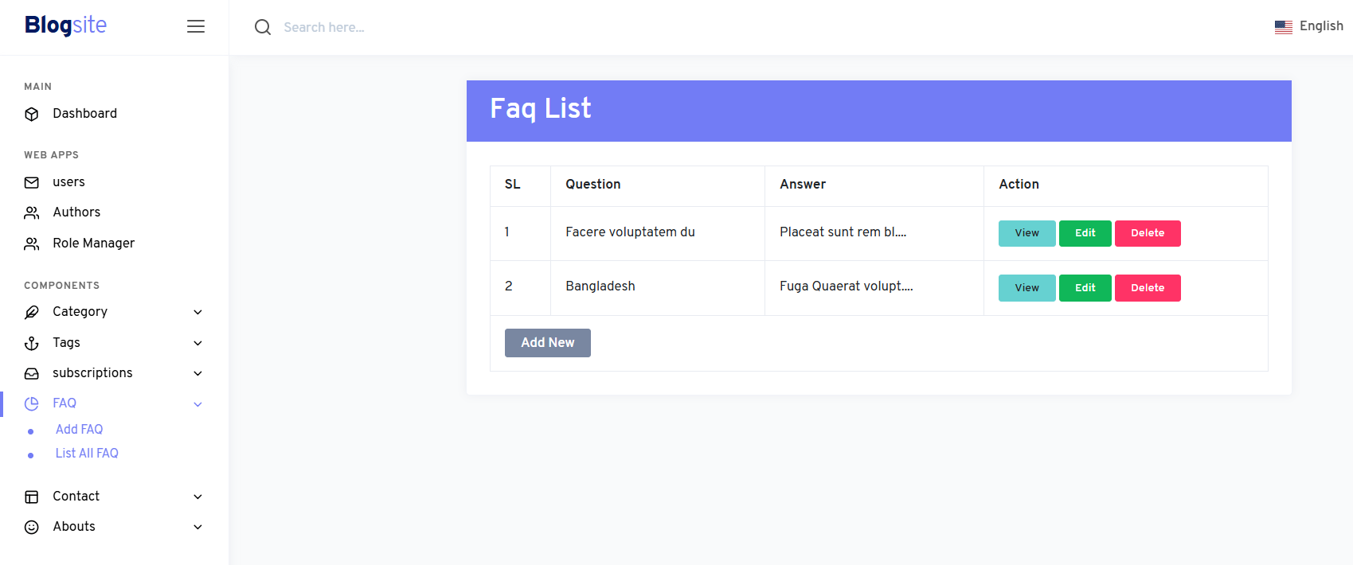
FAQ list show
View ,Edit ,Delete option

Slide 23
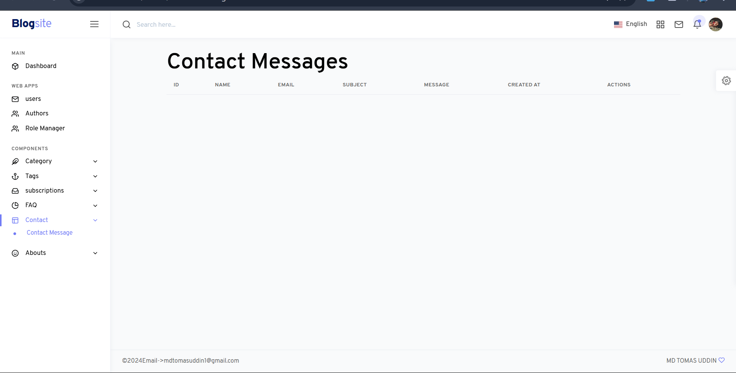
Contact massage show and send

Slide 24
Author add new post
THANK YOU

